Slide 1
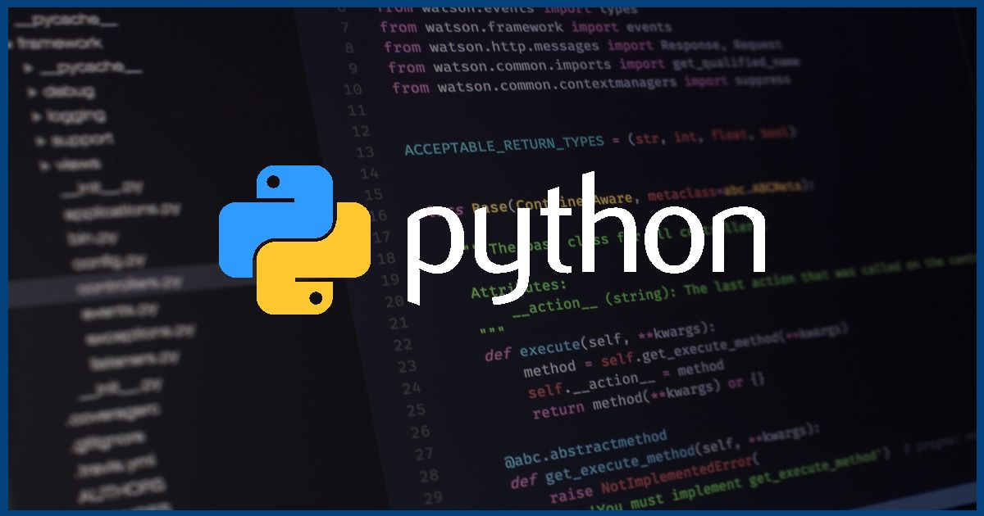

Slide 2
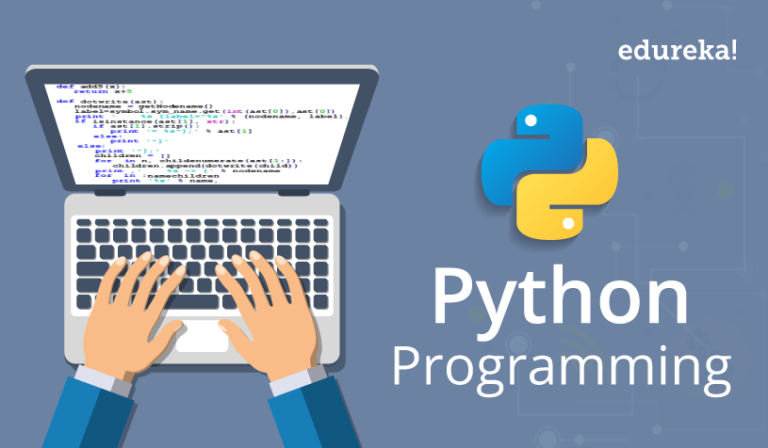
What Is Python!
Python is used by coding beginners e.g: Students Or People who are just getting started. It is used all over the world every day and everyday.

Slide 3
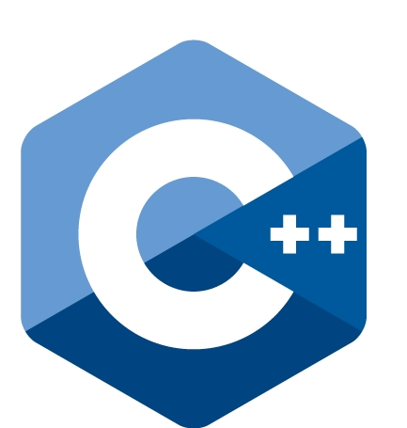
A Better Coding Program
C++

